Slide 1


Outline
Project Description
Experiment
GAN for Audio Synthesis in Manufacturing
GAN Structure
Results
Future Work
Libraries Used : PyTorch, Pandas, SciPy, NumPy, Matplotlib

Slide 2
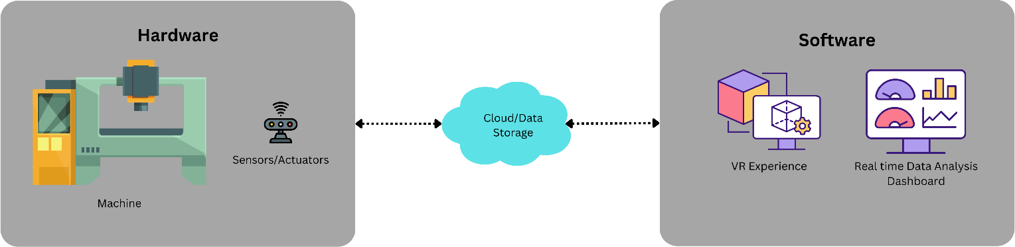
Project Description
The project is for training a Generative Adversarial Network (GAN) which will create spectrograms of audio. Different operations done by a machine like facing, drilling, etc., have different audio patterns.
The objective is to generate audio from its major frequencies instead of sending the entire audio signal from the machine to its digital twins
Digital Twin

Slide 3
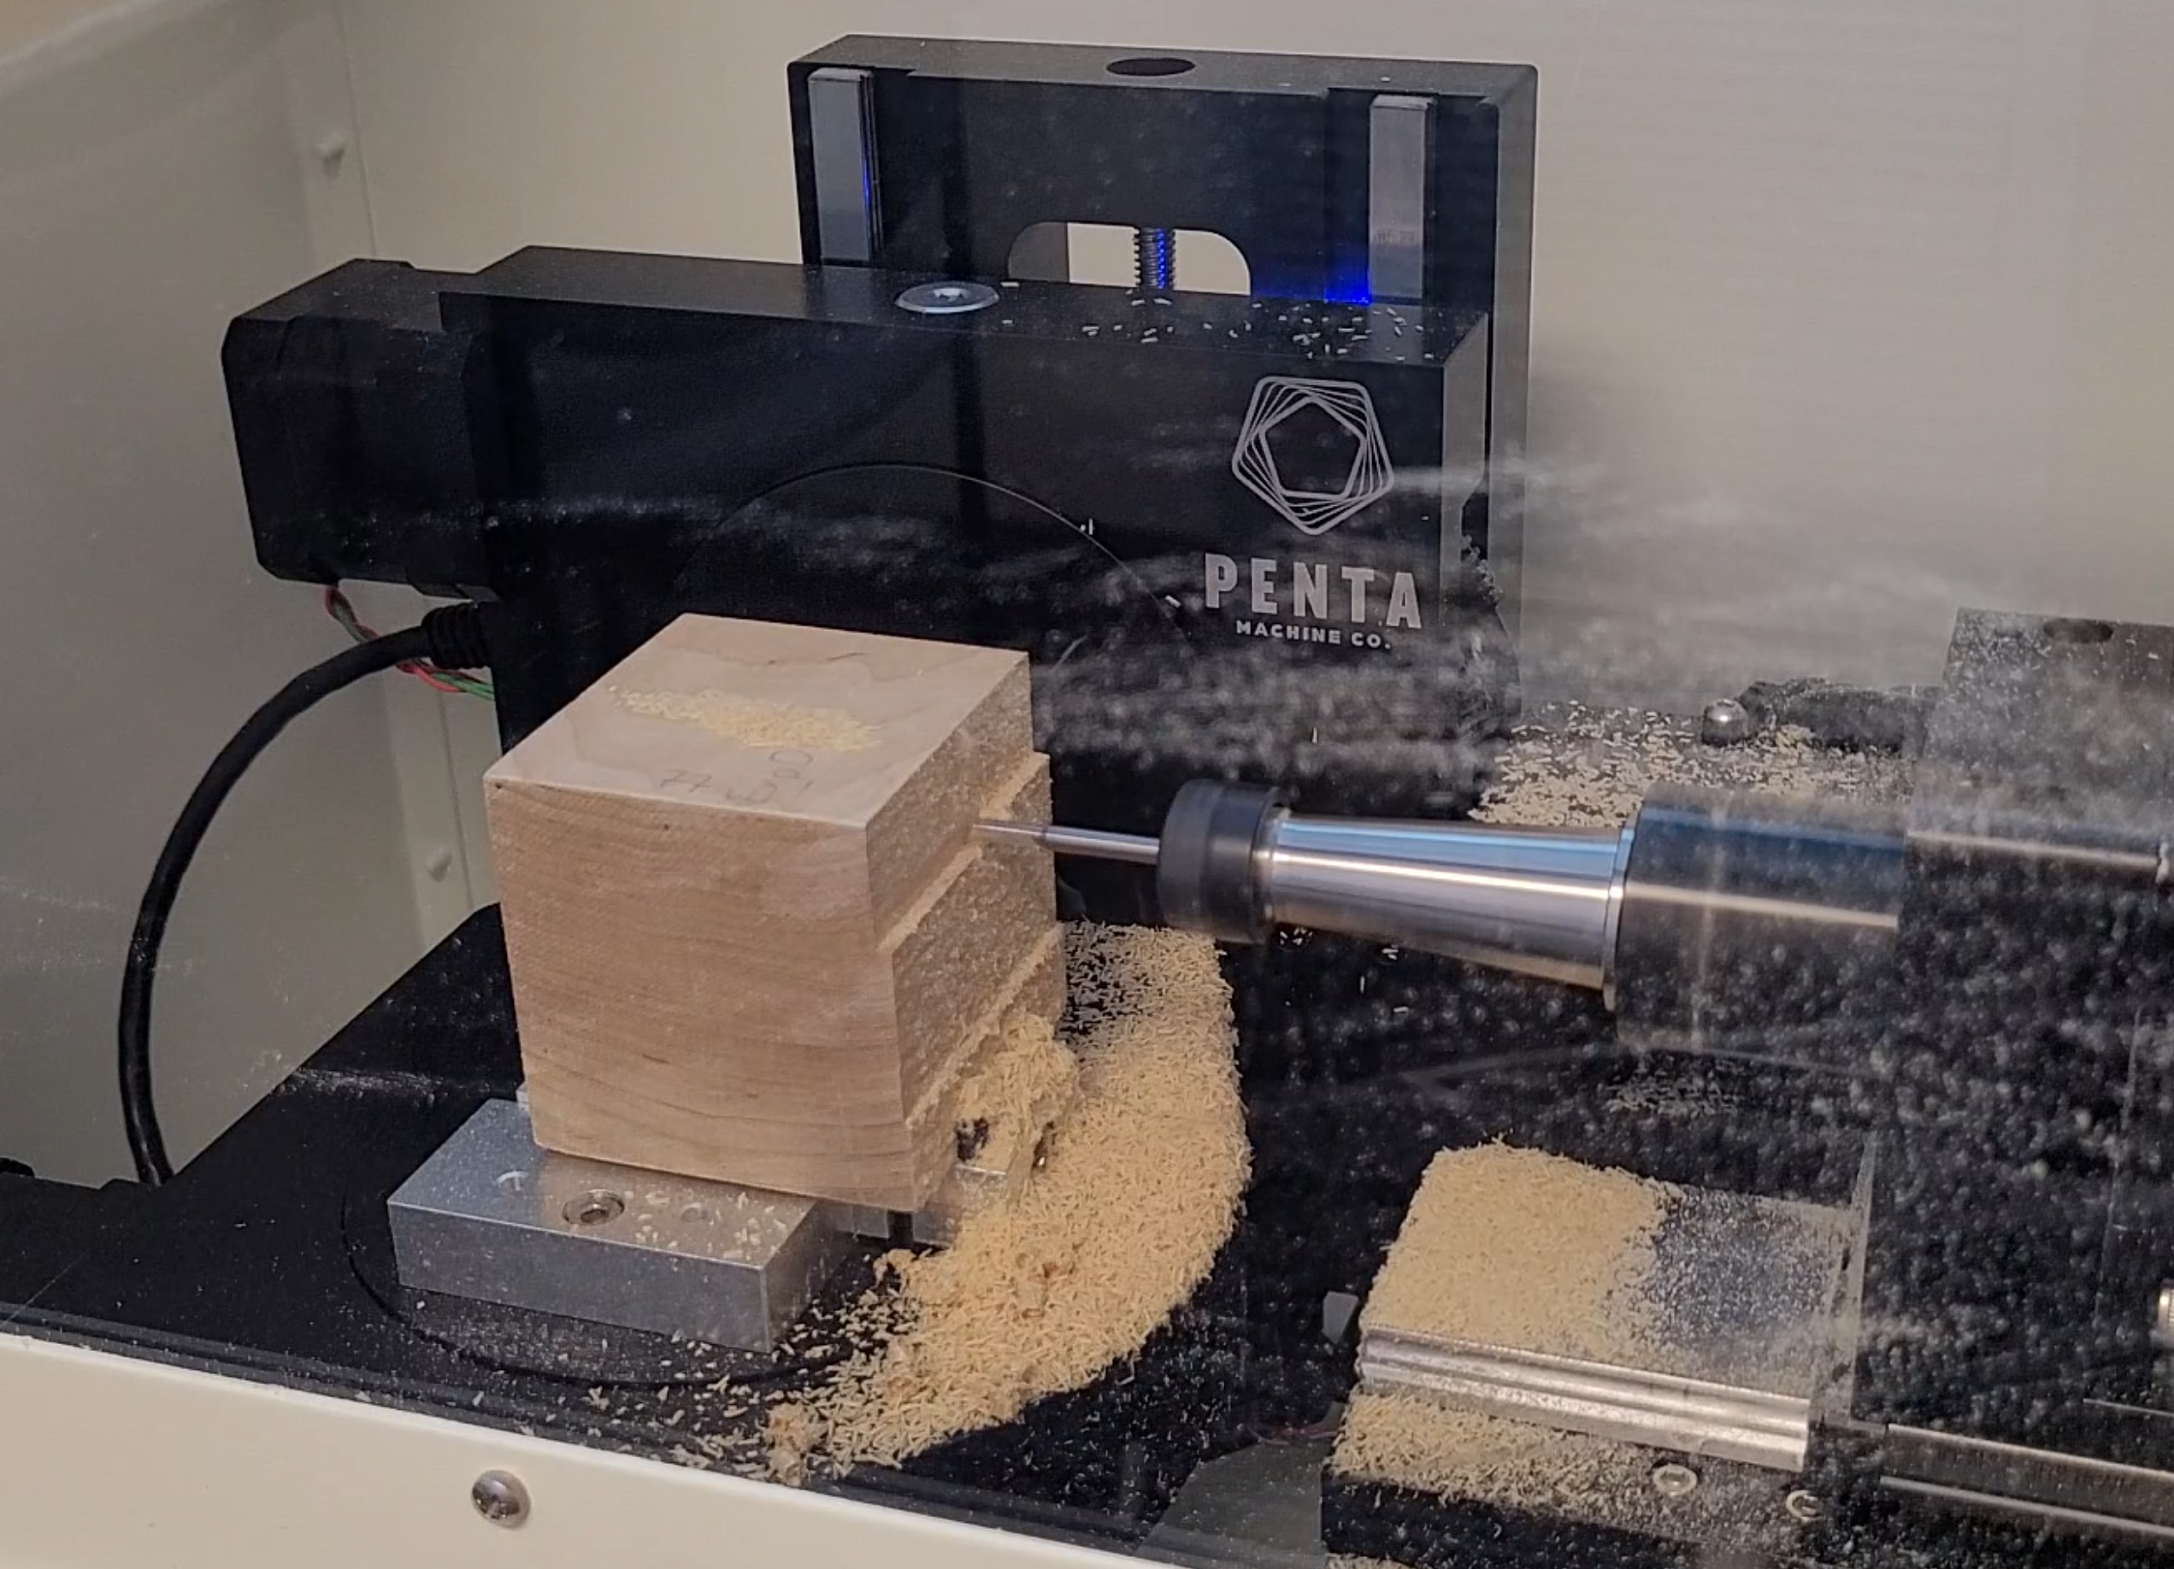
Experiment
The machine used is a Pocket NC and the targeted audio was taken for facing operations using the parameters in the table
The stock piece used was 2*2*2-inch cube made of birch wood
Spindle Speed | 8500 RPM
Feed Per Tooth | 0.001 Inch
Main Depth of Cut | 0.082 Inch
Side Over | 0.070 Inch
1.5 Inch by 2 Inch Facing Operation
Facing 0.2 from the Stock
Table Showing Parameters of the Experiment for the Pocket NC Machine
Experimental Setup

Slide 4
GAN for Audio Synthesis in Manufacturing
Raw Audio
The GAN used for Images is modified
The audio file is split into equal time periods (For e.g. – 0.1 second) and then the Short Time Fourier Transform (STFT) is done for each observation creating spectrograms.
A GAN consists of two neural networks i.e., the Generator and the Discriminator.
The Generator takes an array of random values and generates spectrogram data that has the same array shape as the training spectrogram data.
The Discriminator is fed data from the training data as well as the generated data and determines which is real or generated.
The goal of the generator is to fool the discriminator into thinking that the generated data is real.
Short Time Fourier Transform
Real Spectrograms
Discriminator
Predicated Labels
(Real/Generated)
Generated Spectrograms
Generator
Noise

Slide 5
GAN Structure
Generator Structure
Linear (In Features = 64, Out Features = 128)
LeakyReLU (Negative Slope = 0.2), Dropout (p = 0.4)
Linear (In Features = 128, Out Features = 256)
LeakyReLU (Negative Slope = 0.2), Dropout (p = 0.4)
Linear (In Features = 256, Out Features = 512)
LeakyReLU (Negative Slope = 0.2), Dropout (p = 0.4)
Linear (In Features = 512, Out Features = 1024)
LeakyReLU (Negative Slope = 0.2), Dropout (p = 0.4)
Linear (In Features = 1024, Out Features = 2048)
LeakyReLU (Negative Slope = 0.2), Dropout (p = 0.4)
Linear (In Features = 2048, Out Features = 4096)
LeakyReLU (Negative Slope = 0.2), Dropout (p = 0.4)
Linear (In Features = 4096, Out Features = 8192)
LeakyReLU (Negative Slope = 0.2), Dropout (p = 0.4)
Linear (In Features = 8192, Out Features =5160)
Dropout (p = 0.4)
Reshape (Batchsize*5160 to Batchsize*1*129*40)
Discriminator Structure
Reshape (Batchsize*1*129*40 to Batchsize*5160)
Linear (In Features = 5160, Out Features = 8192)
LeakyReLU (Negative Slope = 0.2) ,Dropout (p = 0.4)
Linear (In Features = 8192, Out Features = 4096)
LeakyReLU (Negative Slope = 0.2) ,Dropout (p = 0.4)
Linear (In Features = 4096, Out Features = 2048)
LeakyReLU (Negative Slope = 0.2) ,Dropout (p = 0.4)
Linear (In Features = 2048, Out Features = 1024)
LeakyReLU (Negative Slope = 0.2) ,Dropout (p = 0.4)
Linear (In Features =1024, Out Features = 512)
LeakyReLU (Negative Slope = 0.2) ,Dropout (p = 0.4)
Linear (In Features = 512, Out Features = 256)
LeakyReLU (Negative Slope = 0.2) ,Dropout (p = 0.4)
Linear (In Features = 256, Out Features = 128)
LeakyReLU (Negative Slope = 0.2) ,Dropout (p = 0.4)
Linear (In Features = 128, Out Features = 1)
Sigmoid

Slide 6
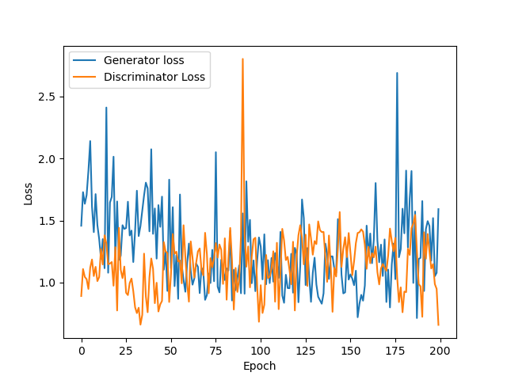
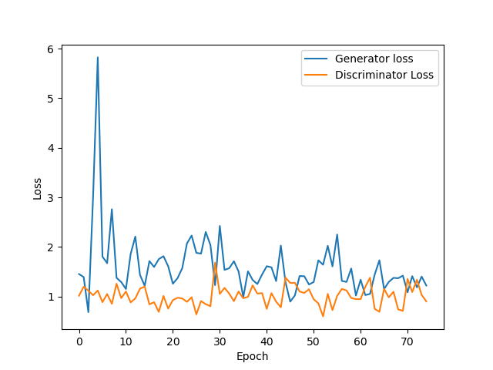
Results
The training of the GAN was done for facing operation
The training was done first for 200 epochs to see if the loss converges
Accordingly, the training was done for 75 epochs
Loss after 200 Epochs
Loss after 75 Epochs

Slide 7
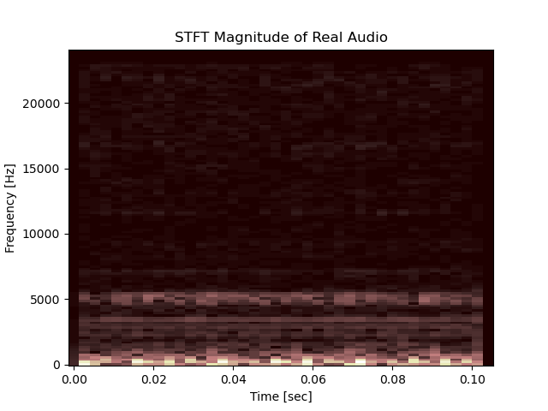
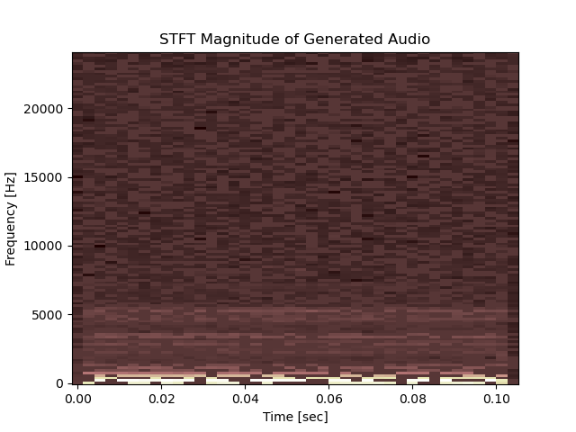
Results Contd.
Visually the generated spectrograms is able to capture the major frequencies of the audio signal. (The spectrogram can be passed through a filter where it would remove the noise in the generated spectrograms)

Slide 8
Future Work
The phase of the audio signal must be implemented with the magnitude to get back the audio signal.
The paper titled GANSynth: Adversarial Neural Audio Synthesis by Engel et al. has implemented it for the NSynth Dataset containing musical notes by different musical instruments
Training GANs for audio of different operations done by a machine and adding classifications of different parameters like spindle speed, depth of cut, feed rate, etc, that were used in an operation

